Slide 1

Arrays
(Operations on Arrays)
@LPU CSE202 C++ Programming

Slide 2
Outline
To declare an array
To initialize an array
Operations on array
@LPU CSE202 C++ Programming

Slide 3


Introduction
Arrays
  Collection of related data items of same data type.
  Static entity – i.e. they remain the same size throughout program execution
Quick yak:
Ask students where they encounter array in routine ex:
Buttons on mobile…(huh now it is touch screen!!!)
@LPU CSE202 C++ Programming

Slide 4
Arrays
Name of array (Note that all elements of this array have the same name, c)
Array
  Group of consecutive memory locations
  Same name and data type
To refer to an element, specify:
  Array name
  Position number in square brackets([])
Format:
    arrayname[position_number]
  First element is always at position 0
  Eg. n element array named c:
    c[0], c[1]...c[n – 1]
c[0]
-45
c[1]
6
c[2]
0
c[3]
72
c[4]
3
c[5]
-89
c[6]
0
c[7]
62
c[8]
-3
c[9]
1
c[10]
6453
c[11]
78
Position number of the element within array c
@LPU CSE202 C++ Programming

Slide 5
Arrays
An array is an ordered list of values
The entire array
has a single name
Each value has a numeric index
c[0] c[1] c[2] c[3] c[4] c[5] c[6] c[7] c[8] c[9]
c
79 87 94 82 67 98 87 81 74 91
An array of size N is indexed from zero to N-1
This array holds 10 values that are indexed from 0 to 9
@LPU CSE202 C++ Programming

Slide 6
Arrays
Array elements are like normal variables
    c[0] = 3;/*stores 3 to c[0] element*/
    scanf (“%d”, &c[1]);/*reads c[1] element*/
    printf (“%d, %d”, c[0], c[1]); /*displays c[0] & c[1] element*/
The position number inside square brackets is called subscript/index.
Subscript must be integer or an integer expression
    c[5 - 2] = 7; (i.e. c[3] = 7)
@LPU CSE202 C++ Programming

Slide 7
Defining Arrays
When defining arrays, specify:
  Name
  Data Type of array
  Number of elements
    datatype arrayName[numberOfElements];
  Examples:
    int students[10];
    float myArray[3284];
Defining multiple arrays of same data type
  Format is similar to regular variables
  Example:
    int b[100], x[27];
@LPU CSE202 C++ Programming

Slide 8
Initializing Arrays
Initializers
    int n[5] = { 1, 2, 3, 4, 5 };
  If not enough initializers given, then rightmost elements become 0
  int n[5] = { 0 }; // initialize all elements to 0
  C arrays have no bounds checking.
If size is omitted, initializers determine it
    int n[] = { 1, 2, 3, 4, 5 };
  5 initializers, therefore 5 element array.
Quick yak:
Probe on the example below ask what happens:
for (i=1;i<5;i++)
for (i=0;i<5;i+=2)
@LPU CSE202 C++ Programming

Slide 9
Initializing Arrays
Array is same as the variable can prompt for value from the user at run time.
Array is a group of elements so we use for loop to get the values of every element instead of getting single value at a time.
Example: int array[5]; // array of size 5
for(int i=0;i<5;i++){// loop begins from 0 to 4
cin>>&array[i];
}
@LPU CSE202 C++ Programming

Slide 10
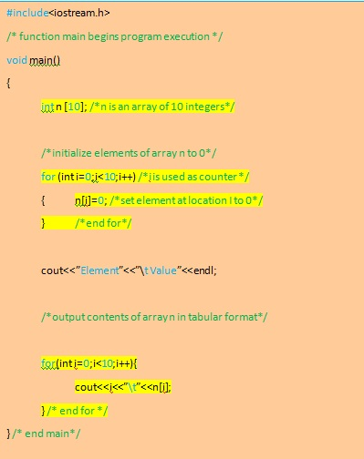
Program of Initializing an array to zero using loop.
@LPU CSE202 C++ Programming

Slide 11
Element Value
0 0
1 0
2 0
3 0
4 0
5 0
6 0
7 0
8 0
9 0
Quick yak:
Discussion can be quickly done on
\t
endl
Used in the program
n[0]
n[1]
0
n[2]
0
n[3]
0
n[4]
0
n[5]
0
n[6]
0
n[7]
0
n[8]
0
n[9]
0
@LPU CSE202 C++ Programming

Slide 12
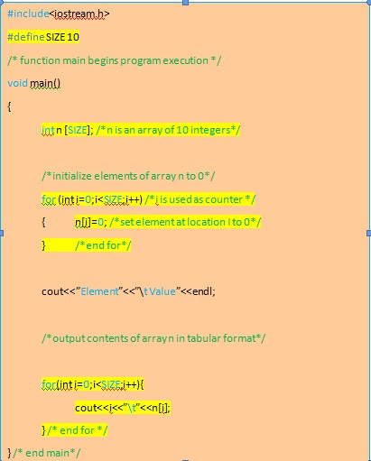
Program of Initializing an array element with calculations using loop.
@LPU CSE202 C++ Programming

Slide 13
Element Value
0 2
1 4
2 6
3 8
4 10
5 12
6 14
7 16
8 18
9 20
n[0]
n[1]
4
n[2]
6
n[3]
8
n[4]
10
n[5]
12
n[6]
14
n[7]
16
n[8]
18
n[9]
20
@LPU CSE202 C++ Programming

Slide 14
Operations on arrays
Insertion of element into an array
Deletion of element from an array
Search of element in an array
@LPU CSE202 C++ Programming

Slide 15
#include<iostream.h>
#include<conio.h>
int main()
{
int a[100],i,n,k, item;
cout<<"how many no to store in array";
cin>>n;
cout<<"Enter the number";
for(i=0;i<=n-1;i++)
cin>>a[i];
cout<<"Enter the no. and its position";
cin>>tem>>k;
k=k-1;
for(i=n-1;i>=k;i--)
{
a[i+1]=a[i];
}
a[k]=item;
cout<<"Contents of the array\n";
for(i=0;i<=n;i++)
{
cout<<a[i];
}
getch();
}
Program to insert an element into an array
@LPU CSE202 C++ Programming

Slide 16
How many no to store in array: 4
Enter the number: 12
14
5
11
Enter the no. and the position: 20 3
Content of the array
12
14
5
20
11
Output
@LPU CSE202 C++ Programming

Slide 17
#include<iostream.h>
#include<conio.h>
int main()
{
int a[100],i,n,k;
cout<<"how many no to store in array"<<endl;
cin>>n;
cout<<"enter the number"<<endl;
for(i=0;i<n;i++)
cin>>a[i];
cout<<"enter the position";
cin>>k;
k=k-1;
for(i=k;i<n;i++)
{
a[i]=a[i+1];
}
cout<<"contents of the array"<<endl;
for(i=0;i<n-1;i++)
{
cout<<a[i];
}
getch();
}
Program to delete an element from an array
@LPU CSE202 C++ Programming

Slide 18
How many no to store in array: 4
Enter the number: 12
14
5
11
Enter the position: 3
Content of the array
12
14
11
Output
@LPU CSE202 C++ Programming

Slide 19
Searching in Arrays
The process of finding a particular element of an array is called searching.
Search an array for a key value.
Two searching techniques:
  Linear search
  Binary search
@LPU CSE202 C++ Programming

Slide 20
Linear search
Linear search
  Simple
  Compare each element of array with key value
  Useful for small and unsorted arrays
It simply examines each element sequentially, starting with the first element, until it finds the key element or it reaches the end of the array.
Example: If you were looking for someone on a moving passenger train, you would use a sequential search.
@LPU CSE202 C++ Programming

Slide 21
#include<iostream.h>
#include<conio.h>
int main()
{
int a[20],key,i,n, c=0;
cout<<“Enter the number of elements:\t";
cin>>n;
cout<<"Enter the elements:\t";
for(i=0;i<n;i++)
cin>>a[i];
cout<<"Enter the element to be found \t";
cin>>key;
for(i=0;i<n;i++)
if(a[i]==key) //comparison
{
cout<<“Key found at location \t"<<i;
c++;
break;
}
if (c==0)
cout<<"element not found in the list";
getch();
return 0;
}
Program of linear search in an array.
@LPU CSE202 C++ Programming

Slide 22
Enter the number of elements: 4
Enter the element: 12
14
5
11
Enter a number to be found: 14
Key found at location 2
Output
@LPU CSE202 C++ Programming

Slide 23
Binary search
Binary search
  Applicable for sorted arrays
The algorithm locates the middle element of the array and compares it to the key value.
  Compares middle element with the key
    If equal, match found
    If key < middle, looks in left half of middle
    If key > middle, looks in right half of middle
    Repeat (the algorithm is repeated on one-quarter of the original array.)
@LPU CSE202 C++ Programming

Slide 24
Binary search
  It repeatedly divides the sequence in two, each time restricting the search to the half that would contain the element.
  This is a tremendous increase in performance over the linear search that required comparing the search key to an average of half of the array elements.
  You might use the binary search to look up a word in a dictionary
@LPU CSE202 C++ Programming

Slide 25
#include<iostream.h>
#include<conio.h>
int main()
{
int ar[100],beg,mid,end,i,n,search;
cout<<"How many numbers in the array: ";
cin>>n;
cout<<"Enter "<<n<<" numbers in ascending order --> ";
for(i=0;i<n;i++)
cin>>ar[i];
beg=0;end=n-1;
cout<<"Enter a number to search: ";
cin>>search;
while(beg<=end)
{
mid=(beg+end)/2;
if(ar[mid]==search)
cout<<"\nItem found at position"<<(mid+1);
if(search>ar[mid])
beg=mid+1;
else
end=mid-1;
}
cout<<"\nSorry! "<<search<<" doesnot found.";
getch();
}
Program of binary search in an array.
@LPU CSE202 C++ Programming

Slide 26
How many numbers in the array: 4
Enter 4 numbers in ascending order→12
14
26
47
Enter a number to search:26
Item found at position 3
Output
@LPU CSE202 C++ Programming

Slide 27

Next Class: Pointers
@LPU CSE202 C++ Programming

